Slide 1
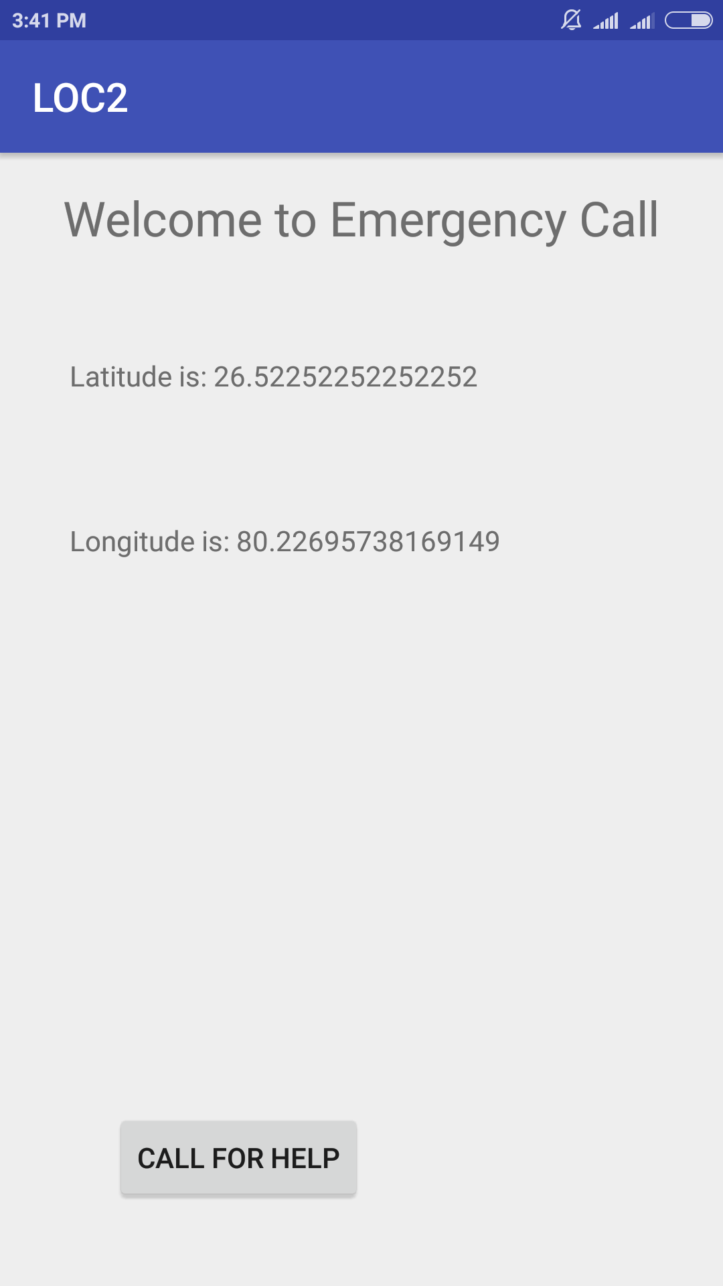
Emergency Call Button
What is Emergency Call Button??
Well its an android app which can call for emergency to helping organisations, like blood connect, women's cell, police, fire, etc ready to help the people in time of need. Will prove to be of great help for the women at the time when someone is trying to harass them.

Slide 2
How it works?
When the victim will open the app, app will try to locate its position, if the victims position gets determined it will be displayed on the app screen. So, that he/she can know about it. and can call for help on a click!! of a button.
How it will help the organisations?
They can easily distribute this app on Play store, and they will get to know about the victims phone no, as well as exact location where he/she needs help, So, their process of working will really become fast and they could manage it very easily. They can add as many numbers how much they want to subscribe.
How it is better than calling the organisation and tell them the problem?
Actually People at the times of need do not have sufficient time to call and explain what problem are they facing?Different organisations can have their own apps and according to the problem they can send the send the message to the relevant organisation.

Slide 3
Now, lets talk about our benefits?
At a completely zero manufacturing cost, as all the APIs used are from Google which are available for free.
No need to modify the core app code for different organisation, one single code will work out for all of them.
There is no need to maintain any database to store things. So, we dont need to maintain anything from time to time
Our plan on how to earn money from this?
Well at initial stage we will roll out a demo app at free of cost.
After the demo period we will sell our app to organisation with an another app for the organisation members to plan up which member will go where?

Slide 4
Our future plan?
At present the app used to send an sms to the help-line no. of the organisation, but we were also planning to implement an facebook group for the organisaton such that they get an updated details on facebook group, i.e. who called from where??
Due to limitation of time right now we had created the app only for the consumer side not for the organisation side which will be provided to them after the demo period.

Slide 5
Thank You...
~ Shashi Kant Gupta (160645)
~ Vaibhav Mittal (160767)

